Slide 1
Java From Functions to Objects
Università di Modena e Reggio Emilia
Prof. Nicola Bicocchi (nicola.bicocchi@unimore.it)

Slide 2
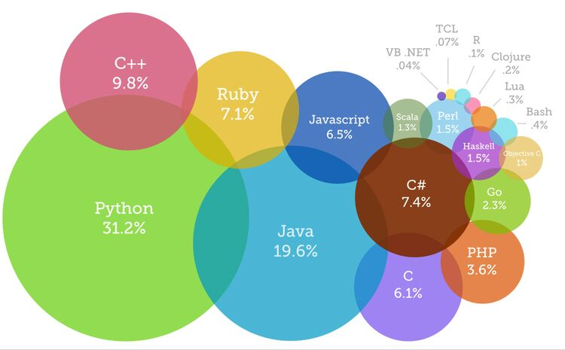
The Present

Slide 3
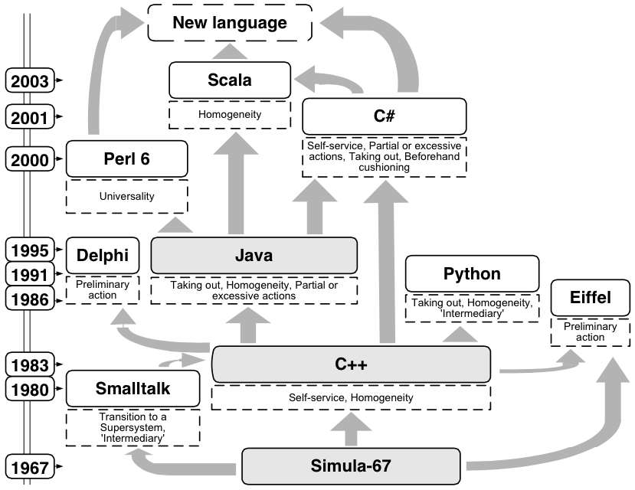
The Past
https://www.youtube.com/watch?v=YqxeLodyyqA

Slide 4


The Future

Slide 5
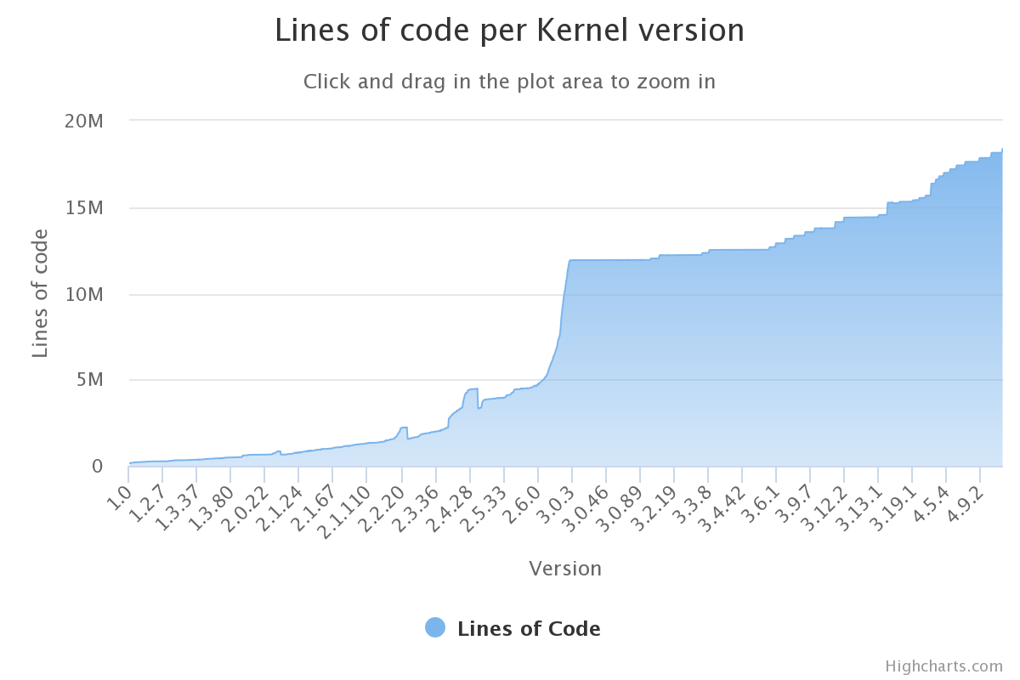
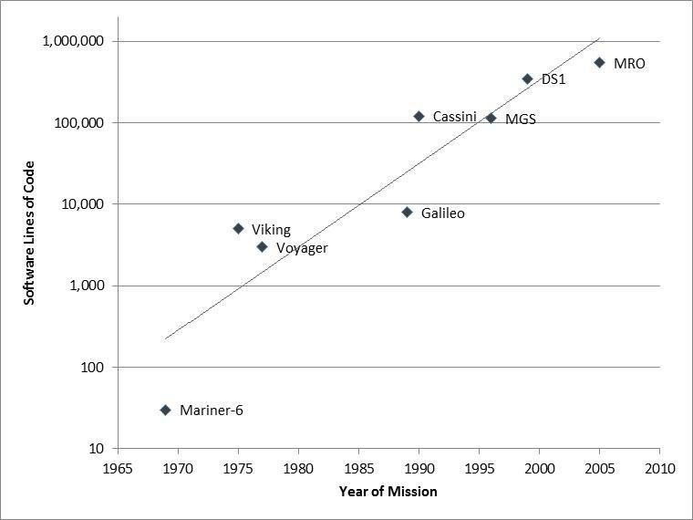
Why OOP?

Slide 6
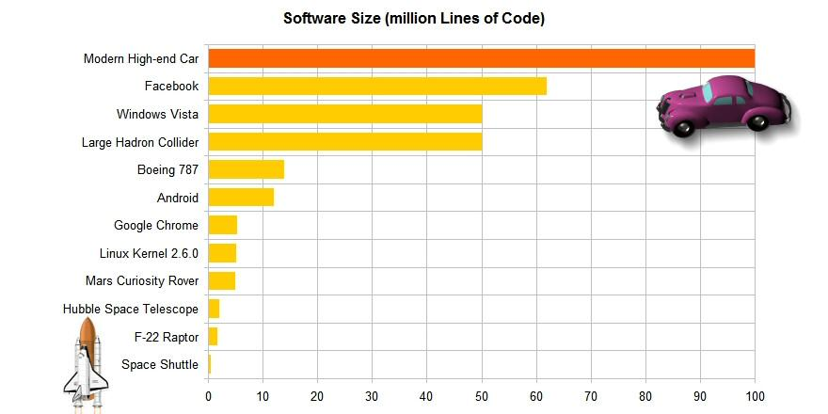
Why OOP?
http://www.informationisbeautiful.net/visualizations/million-lines-of-code/

Slide 7


Why OOP?

Slide 8
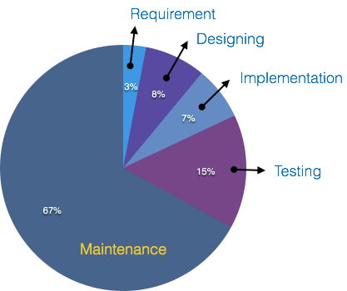
Why OOP?
Procedural programming languages (e.g., Pascal, C) are not suitable for building large software infrastructures
OOP addresses this issue and reduces development and maintenance costs for large and complex software projects
OOP aims at software being secure, re-usable, flexible, documentable, extensible
Instead of focusing on algorithms, optimization and efficiency, OOP focus on programming techniques
OOP considers software as a set of well-defined entities containing both data and functions

Slide 9
Why OOP? (Software crisis)
The causes of the software crisis were linked to the overall complexity of hardware and the software development process. The crisis manifested itself in several ways:
Projects running over-budget
Projects running over-time
Software was inefficient
Software was difficult to maintain
https://en.wikipedia.org/wiki/Software_crisis

Slide 10
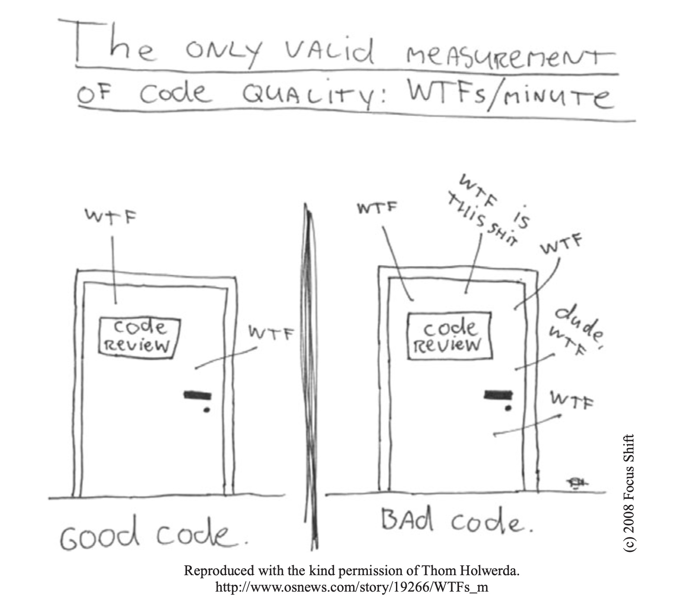
Errors / 1K SLOC
Industry Average
25 errors / 1K SLOC
Corporate Applications
5 errors / 1K SLOC
Cleanroom development technique
0.5 errors / 1K SLOC

Slide 11
Fuctions vs Objects

Slide 12
Procedural Programming
#include <stdio.h> #include <stdlib.h> void init(int v[], int size) {
int i;
for (i = 0; i < size; i++) {
v[i] = rand() % 100;
}
}
void sort(int v[], int n) {
int i, j, tmp, changed;
for (i = 0; i < n-1; i++) {
changed = FALSE;
for (j = 0; j < n - i - 1; j++) {
if (v[j] > v[j + 1]) {
changed = TRUE;
tmp = v[j];
v[j] = v[j + 1];
v[j + 1] = tmp;
}
}
if (!changed) break;
}
}
int search(const int v[], int size, int value) {
int i;
for (i = 0; i < size; i++ ) {
if (v[i] == value) {
return i;
}
}
return -1;
}
void show(int v[], int size) {
int i;
for (i = 0; i < size; i++) {
printf("[%d] %d\n", i, v[i]);
}
}
int main() {
int v[100];
int n = sizeof(v) / sizeof(v[0]);
init(v, n);
sort(v, n);
search(v, n, 10);
}

Slide 13
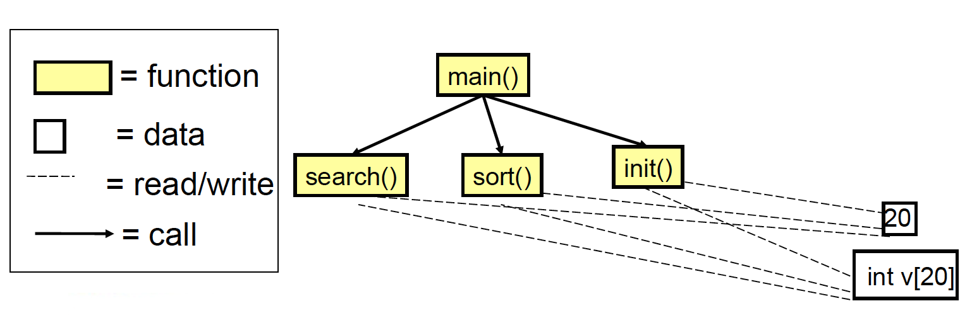
Modules and relationships

Slide 14
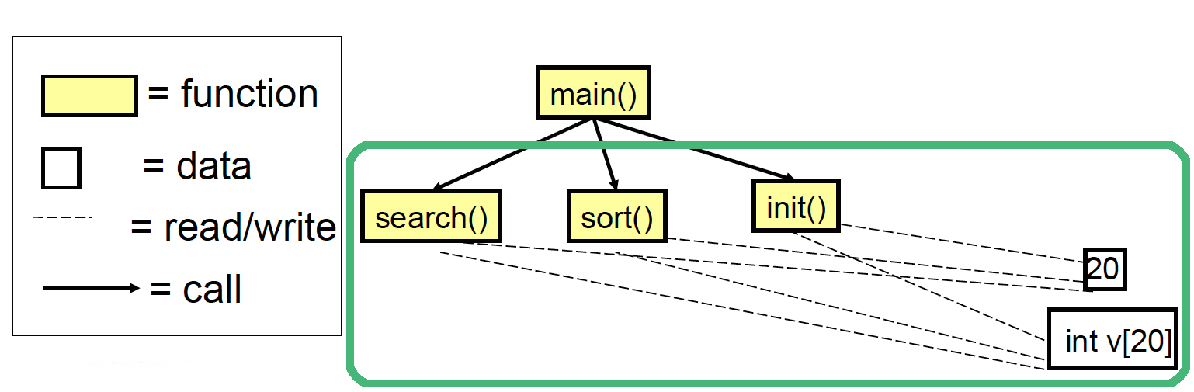
Issues
No clear relationship between
The actual array (int v[20])
Operations on the array (search(), sort(), init())
Need of a dedicated variable for storing the array size
int v[100]; int n = sizeof(v) / sizeof(v[0]);
Initialization not guaranteed

Slide 15
Issues
Reuse of code limited
Data and operations are separate. This makes it complex to reuse existing code in other projects
Data protection limited
Unprotected data accessible from vast portions of the source code. After a certain stage, debug becomes a nightmare!
Decomposition limited
Large scale projects require a large scale working force (many teams). Unprotected data, separate from operations, makes it hard to decompose

Slide 16
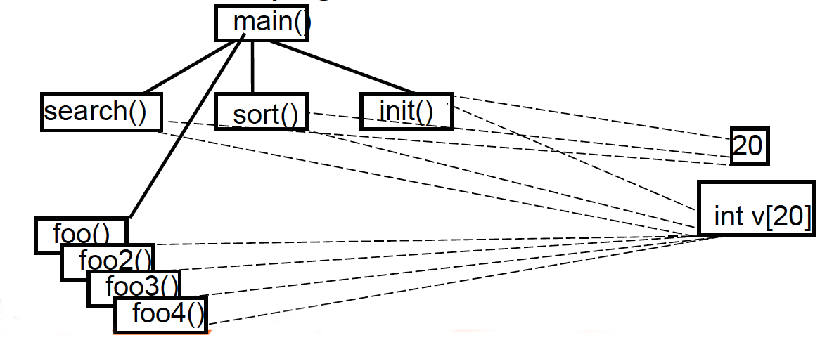
Issues in the long run
External functions can also use array’s data, leading to a growing number of relationships over time
Source code becomes difficult to understand and maintain (spaghetti code)

Slide 17
Solution!
Define a primitive concept (a special vector) in which data and operations are modularized together!

Slide 18
Object-Oriented approach
public class Vector {
int[] v;
public Vector(int capacity) {
this.v = new int[capacity];
init();
}
void sort() {
boolean changed;
for (int i = 0; i < v.length-1; i++) {
changed = false;
for (int j=0; j < v.length - i - 1; j++) {
if (v[j] > v[j + 1]) {
changed = true;
int tmp = v[j];
v[j] = v[j + 1];
v[j + 1] = tmp;
}
}
if (!changed) break;
}
}
void init() {
Random rnd = new Random();
for (int i = 0; i < v.length; i++) {
v[i] = rnd.nextInt(100);
}
}
int search(int value) {
for (int i = 0; i < v.length; i++) {
if (v[i] == value) {
return i;
}
}
return -1;
}
void show() {
for (int i = 0; i < v.length; i++) {
System.out.printf("[%d] %d\n", i, v[i]);
}
}
}

Slide 19
Object-Oriented approach
int main() {
int v[100];
int n = sizeof(v) / sizeof(v[0]);
init(v, n);
sort(v, n);
search(v, n, 10);
}
public static void main(String[] args) {
Vector v1 = new Vector(20);
Vector v2 = new Vector(30);
v1.sort();
v1.show();
v1.search(10);
}

Slide 20
OOP Engineering Approach

Slide 21
An engineering approach
OOP implies a shift to a client-server model
Do not uses functions for processing data
Ask entities to deliver services using internal data
operation(object, params)
For example:
search(vector, value)
object.operation(params)
For example:
vector.search(value)

Slide 22
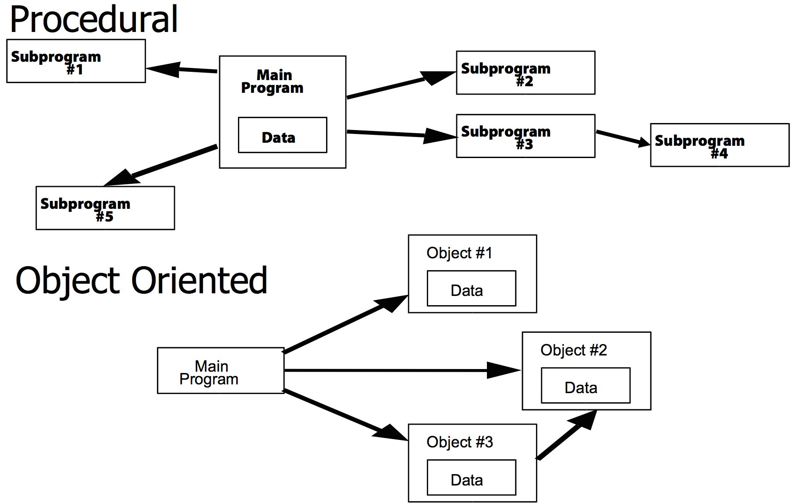
An engineering approach

Slide 23
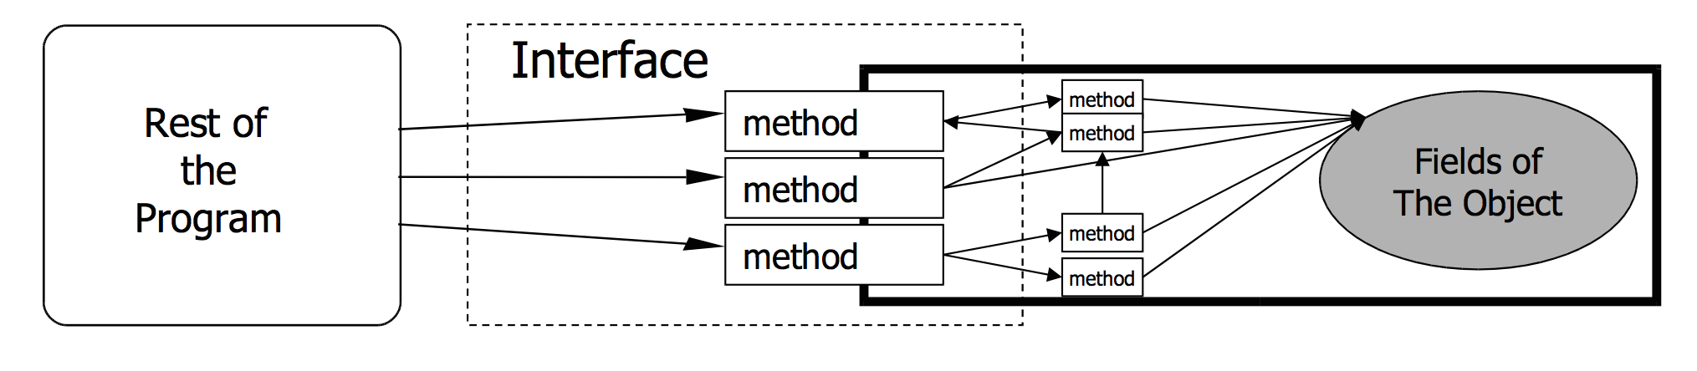
An engineering approach
Given an object oriented program, we have to:
Identify the needed components
Define component interfaces
Define how components interact each other through their interface

Slide 24
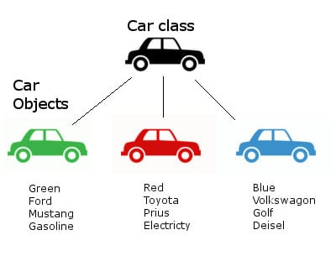
Classes and objects
public class Car {
String color;
String brand;
String model;
String fuel;
public Car(color, brand, model, fuel) {
this.color = color;
this.brand = brand;
this.model = model;
this.fuel = fuel;
}
/* ... */
}
Car c1 = new Car(Green, Ford, Mustang, Gasoline);
Car c2 = new Car(Red, Toyota, Prius, Electricity);
Car c3 = new Car(Blue, VW, Golf, Diesel);

Slide 25
Classes and objects
Class (the description of objects’ structure):
Data (ATTRIBUTES)
Operations (METHODS)
Object (class instance)
Identity
Type
Internal state
A class is like a type definition. No data is allocated until an object is created from the class
The creation of an object is called instantiation. The created object is often called an instance
No limit to the number of objects that can be created from a class
Each object is independent. Changing one object doesn't change the others

Slide 26
OOP Key Features

Slide 27
Encapsulation
Encapsulation is defined as the wrapping up of data under a single unit. It is the mechanism that binds together code and the data it manipulates.
Another way to think about encapsulation is, it is a protective shield that prevents the data from being accessed by the code outside this shield.

Slide 28
What it possible before?
// point.h
struct Point;
struct Point* makePoint(double x, double y);
double distance (struct Point *p1, struct Point *p2);
// point.c
#include "point.h"
struct Point {
double x,y;
};
struct Point* makepoint(double x, double y) {
struct Point* p = malloc(sizeof(struct Point));
p->x = x;
p->y = y;
return p;
}
double distance(struct Point* p1, struct Point* p2) {
double dx = p1->x - p2->x;
double dy = p1->y - p2->y;
return sqrt(dx*dx+dy*dy);
}

Slide 29
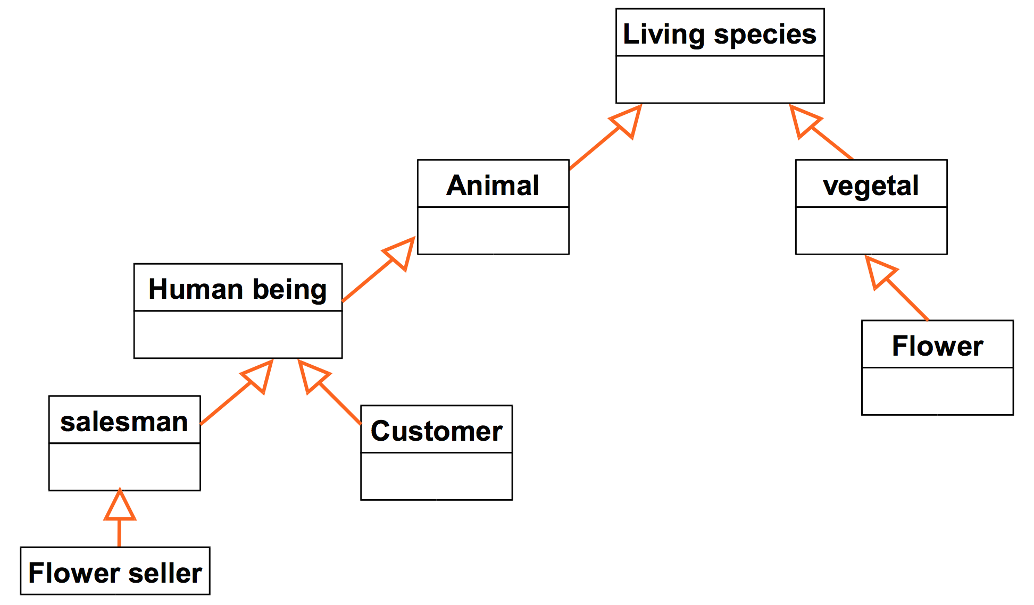
Inheritance
In Java, a class can inherit attributes and methods from another class.
The class that inherits the properties is known as the sub-class or the child class. The class from which the properties are inherited is known as the superclass or the parent class.
In Inheritance, the properties of the parent class are acquired by the derived classes.

Slide 30
What it possible before?
// namedPoint.h
struct NamedPoint;
struct NamedPoint* makeNamedPoint(double x, double y, char* name);
void setName(struct NamedPoint* np, char* name);
char* getName(struct NamedPoint* np);
// namedPoint.c
#include "namedPoint.h"
struct NamedPoint {
double x,y;
char* name;
};
struct NamedPoint* makeNamedPoint(double x, double y, char* name) {
struct NamedPoint* p = malloc(sizeof(struct NamedPoint));
p->x = x;
p->y = y;
p->name = name;
return p;
}
void setName(struct NamedPoint* np, char* name) {
np->name = name;
}
char* getName(struct NamedPoint* np) {
return np->name;
}
#include "point.h"
#include "namedPoint.h"
#include <stdio.h>
int main(int ac, char** av) {
struct NamedPoint* origin = makeNamedPoint(0.0, 0.0, "origin");
struct NamedPoint* upperRight = makeNamedPoint (1.0, 1.0, "upperRight");
printf("distance=%f\n", distance(
(struct Point*) origin,
(struct Point*) upperRight));
}

Slide 31
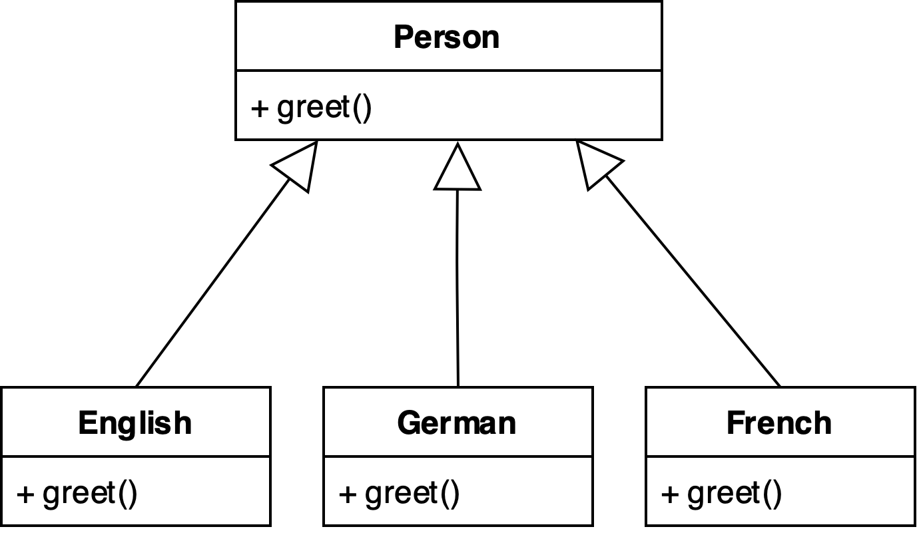
Polymorphism
Inheritance lets us inherit attributes and methods from another class.
Polymorphism uses inherited methods to perform the same action in different ways.
Tell-Don’t-Ask principle: instead of asking an object about its state and then performing actions, it’s much easier to simply tell the object what it needs to do and let it decide for itself how to do that.

Slide 32
What it possible before?
#include <stdio.h>
void copy() {
int c;
while ((c = getchar()) != EOF)
putchar(c);
}
struct FILE {
void (*open)(char* name, int mode);
void (*close)();
int (*read)();
void (*write)(char);
void (*seek)(long index, int mode);
};

Slide 33
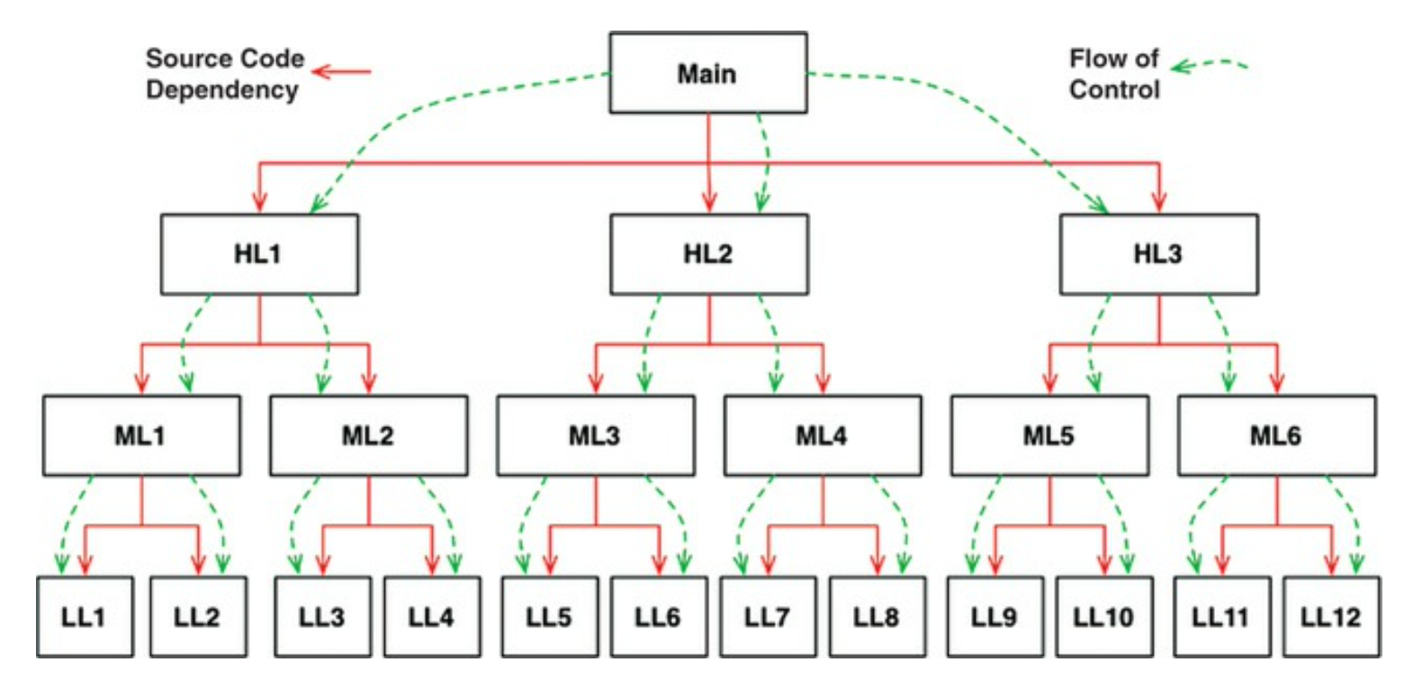
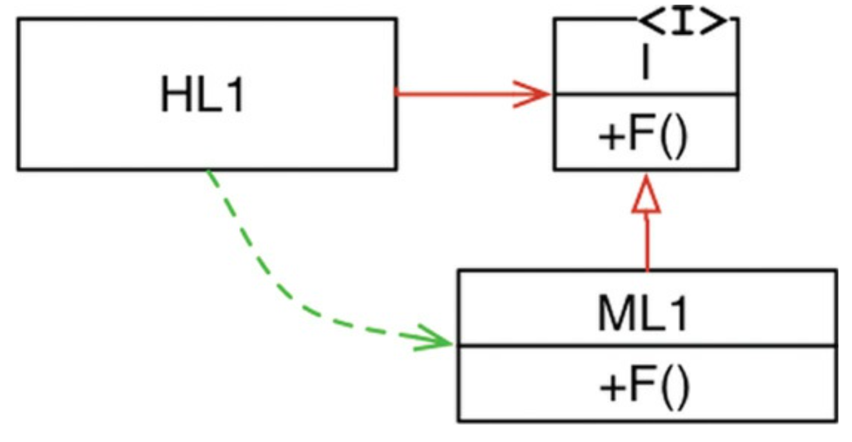
So What?
OO is the ability, through the use of polymorphism, to gain absolute control over every source code dependency in the system.
It allows the architect to create a plugin architecture, in which modules that contain high-level policies are independent of modules that contain low-level details.
The low-level details are relegated to plugin modules that can be deployed and developed independently from the modules that contain high-level policies.

Slide 34
Advantages of OOP
Cooperative development
Different people working on different classes
Incremental design and development
Define new classes by extending the exsisting ones
Code management
Bugs on object data are easy to spot. Since data are not visible from the outside, errors mostly occurs in the object handling the data
Changes on a specific class do not impact other classes (unless external interface is modified)

Slide 35
Disadvantages of OOP
Needs a Object Oriented way of thinking
Complex design (e.g., Which classes?, How many classes?)
Benefits only occur in large programs
Programs < 1K lines, spaghetti code is still understandable and fast to write
Programs > 10K lines, spaghetti code is no more comprehensible and, thus, not maintainable

Slide 36
Wisdom Pills
Learning to write clean code is hard work. It requires more than just the knowledge of principles and patterns. You must sweat over it. You must practice it yourself, and watch yourself fail. You must watch others practice it and fail. You must see them stumble and retrace their steps. You must see them agonize over decisions and see the price they pay for making those decisions the wrong way. -- Clean Code, Robert C. Martin

